Slide 1
DATA STRUCTURES & ALGORITHMS lab 07
COMP201l

Slide 2
QUEUE Implementation and Operations
OBJECTIVE:
To understand Queue concept and Implementation of Queue.
Software/Tool:
Dev C++

Slide 3
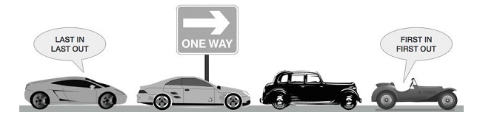
queue
Queue is an Abstract Data Type (ADT)
Somewhat similar to stack
Unlike stacks, a queue is open at both its ends
One end is always used to insert data (enqueue) and the other is used to remove data (dequeue)

Slide 4
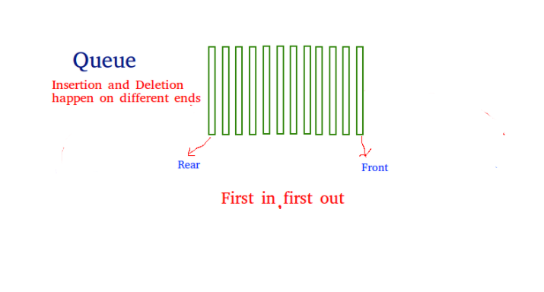
Queue
Queue follows First-In-First-Out methodology, i.e., the data item stored first will be accessed first.

Slide 5
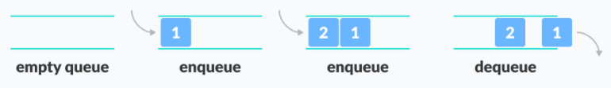
QUEUE – Enqueue & dequeue
In the below example, since 1 was kept in the queue before 2, it was the first to be removed from the queue as well. It follows the FIFO rule.
In programming terms, putting an item in the queue is called an "enqueue" and removing an item from the queue is called "dequeue".

Slide 6
applications
What are some real-life Queue applications?

Slide 7
applications
When a resource is shared among multiple consumers. Examples include CPU scheduling, Disk Scheduling.
Handling of interrupts in real-time systems. The interrupts are handled in the same order as they arrive i.e First come first served.
In real life scenario, Call Center phone systems uses Queues to hold people calling them in an order, until a service representative is free.

Slide 8
Tasks
Design and Implement a program using C++ having two interfaces one for Queue using Array and the other one is for Queue using Link List. User will choose the one he/she wants to use and will input (Enqueue) after the queue is filled, a function which prints the queue in reverse manner. After that remove half of data elements (Dequeue) and print the elements in queue.

